Slide 1
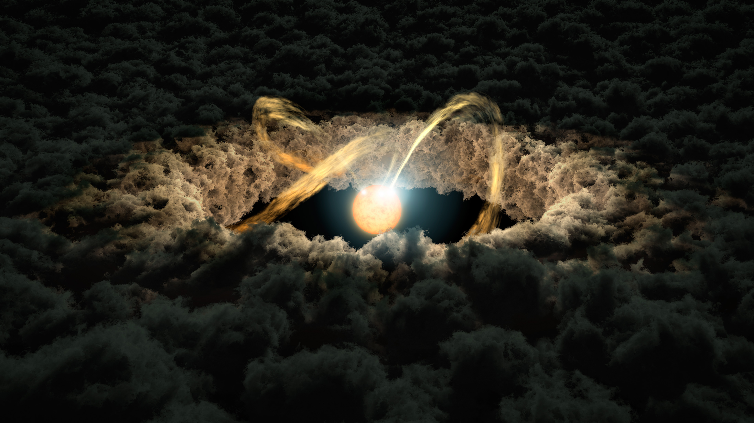
Complex Organic Molecules in Protoplanetary Disks
Kilian Lieret
(17R58509)
Academic Supervisor (TITECH): Department (TITECH): Home Institution: | Hideko Nomura Earth & Planetary Sciences Ludwig-Maximilians University, Technical University Munich
Notes:
25 (15, )
Hi! My project was about chemistry in space: „Complex Organic Molecules in Protoplanetary Disks“.
Maybe start with a bit of background on myself

Slide 2



Introduction
What? Why? How? Results!
Me:
  BA in Mathematics
  BA in Physics
  towards end of MA “Theoretical and Mathematical Physics”
My project: Astrochemistry (Earth & Planetary Sciences)
What I actually did: Programming (?)
Notes:
40
I Have a Bachelor in Maths and one in Physics and am currently doing Theoretical and Mathematical Physics, close to the end of my master > So kind of the maths, physics geek. [CLICK]
But then my project was about Astrochemistry [CLICK]
But what I actually did was Programming while waiting for simulations to finish.
So maybe a bit interesting because those three things don‘t really fit together at the first glance!
So let‘s talk more about my research project:
Maybe short word to the structure: The order is roughly: [CLICK] What, [CLICK] Why, [CLICK] How, [CLICK] Results?

Slide 3
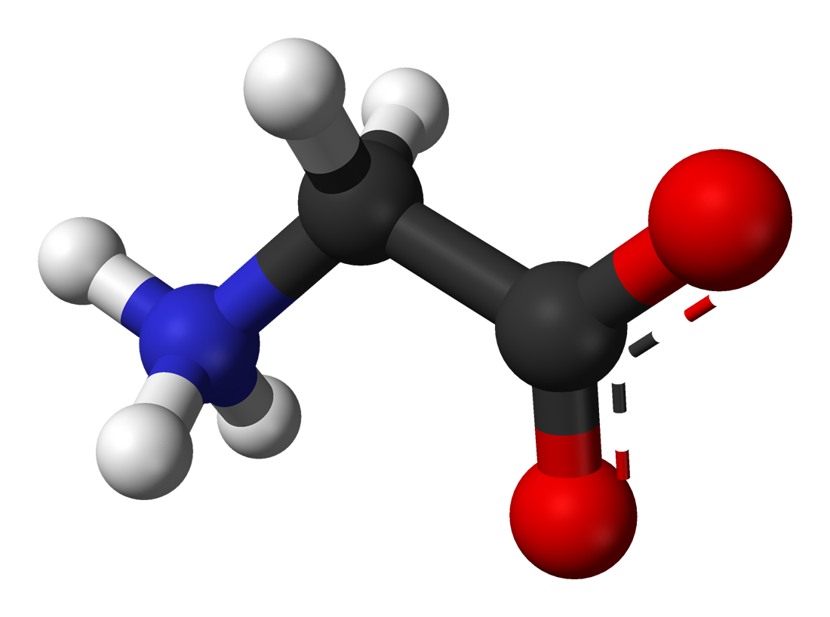
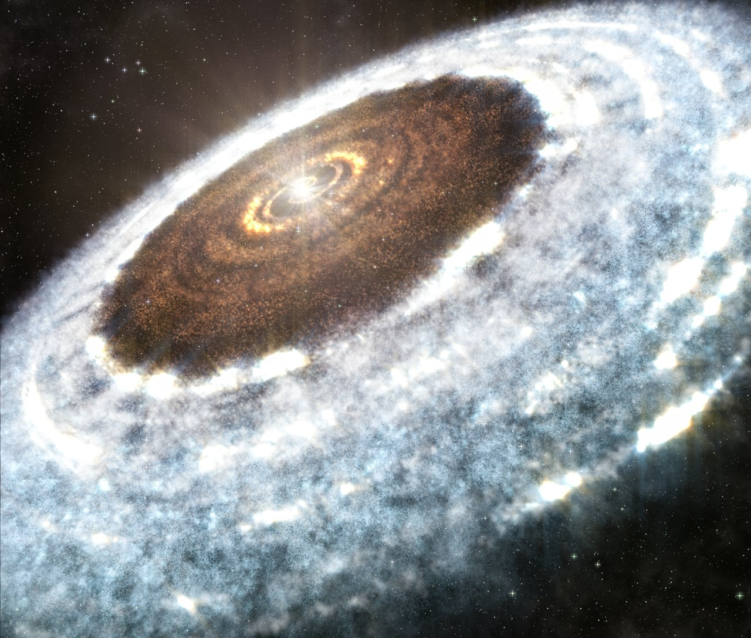
What?
What? Why? How? Results!
“
Large Molecules with Carbon
(Large: >6 atoms)
Glycine
Complex Organic Molecules in
Protoplanetary Disks
”
Planet forming regions with a lot of dust
Notes:
45
So starting with what does the title “Complex Organic Molecules in Protoplanetary disks” actually mean?
[CLICK] Complex Organic Molecules are relatively large molecules which contain carbon. And relatively large in our astrophysical context means, more than 6 atoms. Which for earth is ridiculously small, but then again it’s in space.
[CLICK] And protoplanetary disks, well, those are planet forming regions, which usually are big areas filled with dust, which usually forms a disk around a star.
So we are interested in finding complex molecules in planet forming regions.

Slide 4
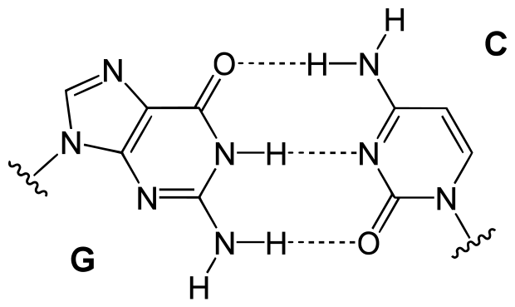
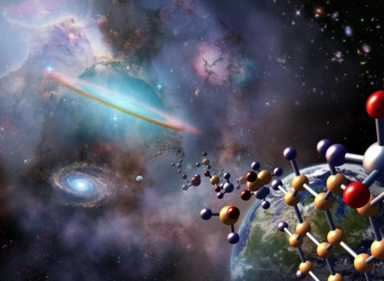
Why?
What? Why? How? Results!
Origin of Life
Building Blocks of Life?
Complex Organic Molecules
First created in protoplanetary disks?
Notes:
45
So fair question: WHY are we interested in that?
One of the big buzzwords I can throw out to answer that question is: [CLICK] The origin of life.
When we ask ourselves where does life come from, naturally one of the first things to ask is, [CLICK] „Where do the building blocks of life (that is, complex organic molecules= come from?“.
[CLICK] And there‘s one prominent theory which says: Those molecules actually were first formed in space, among others in protoplanetary disks. (Out of which the planets formed) and then also later continuously brought to earth via comets and meteorites.
I hope that’s enough for WHY, because now I will talk about HOW we tried to investigate the formation of those molecules.

Slide 5
How?
What? Why? How? Results!
Simulation: Chemical Reaction Network
Chemicals (Abundances)
at t
Chemicals (Abundances)
at t+1
Physical Parameters
(Temperature…)
My Goal: Understand the Influence
of these parameters!
Chemical Reactions
Notes:
45
We tried to simulate, not just observe, how the chemistry develops with time.
[CLICK] This is done with so called Chemical Reaction Networks. Basically we have a large set of known [CLICK] chemical reactions and we know how often they occur, which gives us some [CLICK] differential equations.
[CLICK] So if we start with some initial chemicals, and we solve them, we know what chemicals we have after one time step.
[CLICK] And if we repeat and repeat this step, we can see how the abundance of certain chemicals [CLICK] develops with time.
Specifically that also takes into account [CLICK] physical parameters, such as temperature, and my project was about investigating the influence of those parameters on the outcomes.

Slide 6
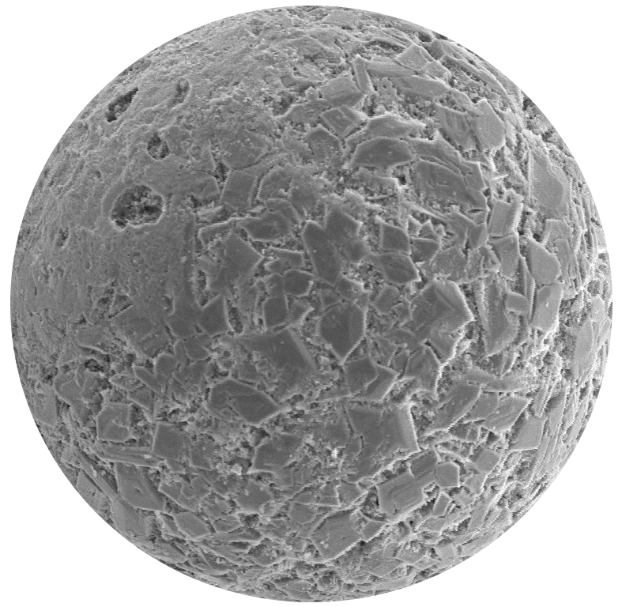
How?
What? Why? How? Results!
Protoplanetary disks: gas molecules and dust grains
surface
mantle
core
Surface reactions!
Molecule sticking to surface
Notes:
40
One more thing to add: We do this in protoplanetary disks, which is a lot of empty space but also contains [CLICK] gas molecules which fly around and stick to dust grains, tiny dust particles floating around.
And when the molecules stick to them, so we have [CLICK] chemistry happening on the surface of those grains. And in general chemistry there works much more efficiently than in the surrounding gas.
So taking into account those grains, and also that they are made up of a [CLICK] core, a mantle and a reactive surface layer is the crucial part of the simulation.

Slide 7
How?
What? Why? How? Results!
x10
x600
Notes:
75
Ok, so let’s talk about my part in all of this or my daily workflow. At the heart of everything, of course, is the simulation. I run it, and I get some output data. And, as I said it depends on some physical parameters, like the temperature. And I’m interested in how the outcome changes if I change this parameter. So I’m not only running this simulation once or twice, but hundreds of times. And I spent most of my time on trying to make this as easy as possible, by embedding the simulation in a bigger framework.
[CLICK] So I wrote a program, which repeatedly calls the simulation for different e.g. temperatures and takes the output and gives a neat name and does a lot of book-keeping to remember what the data actually corresponds to.
[CLICK] And all those output files end up on a big pile, here (currently about …. data files), and later when I want to compare them, or plot them, I have to [CLICK] pick out the right ones again, and then [CLICK] “parse them”, so extracting the correct data out of them, and then finally [CLICK] plot them.
In the end for each of the runs of the simulation we get one line in our plot. So in this example we called the simulation for the temperatures 10, 20 and 30 K, and those go one time around in this whole cycle and finally I can compare them in this picture. And this is for one molecule, but actually I have 600 of them, so I also get 600 single plots. And also I can consider a whole lot of different things I want to study, so I also have about 10 of those plotting scripts.

Slide 8
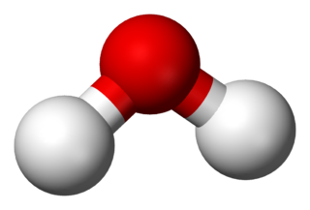
Results
What? Why? How? Results!
Low
temperatures
How much water
is sticking on a
Dust grain?
High
temperatures
TIME
Notes:
50
So maybe one exemplary result: This graph shows how much water is sticking on a dust grain [CLICK].
On the x axis, we have the time, a one million year logarithmic time [CLICK].
So this graph shows us how the abundances of water changes with time. But that depends on the temperature, so we actually have different lines, for different temperatures. [CLICK].
And as we can see, for low temperatures, 10K, 20K …. not much changes.
But once we go over 120K, we see a steep drop [CLICK].
What happens here is that the Water molecules that stick to our dust particle actually have enough thermal energy to go back into the gas phase [CLICK], which is why we see the drop for the amount of water sticking to the GRAIN.

Slide 9
Results
What? Why? How? Results!
Created thousands of pages of plots
  hopefully contributed to the understanding of the influence of some physical parameters on Astrochemistry
Wrote a framework of more than 4000 lines of code
  hopefully the next student will use it to run similar studies much faster
Notes:
40
So to wrap it up, I ran the simulation hundreds of times, collected more than 600 data files and made thousands of pages plots. Of course I didn’t read every single page, but hopefully I contributed something to our understanding of how important physicals parameters are for interstellar chemistry.
[CLICK] I also wrote a framework of 4000 lines of code and hopefully next student will be able to pick up the work where I left and can do the same studies in but a fraction of the time it took me. So I also really focused on making manuals for my programs and documenting everything thoroughly in order for that to happen

Slide 10

Thank you for
Your
attention!
Thank you for A memorable summer!
Notes:
15
So that’s it. It was really nice being here and also meeting all of you, I had tons of fun in Japan, on Mount Fuji, in Hakkone, in Tokyo. And thank you for your attention.

Slide 11
Picture Sources
#1 Background title page: https://www.nasa.gov/sites/default/files/thumbnails/image/pia20645_main.jpg
#3 Protoplanetary Disk: https://pl.wikipedia.org/wiki/Plik:Artist%E2%80%99s_impression_of_the_water_snowline_around_the_young_star_V883_Orionis.jpg
#3 Glycine: https://commons.wikimedia.org/wiki/File:Glycine-from-xtal-2008-3D-balls.png
#4 Pseudo-Panspermia: https://blogs-images.forbes.com/startswithabang/files/2016/11/astrochem3-1200x900.jpg
#5 Chemical Reactions: The Physics and Chemistry of the Interstellar Medium of A. G. G. M. Tielens
#6, #8 Grain image (edited): https://spaceshipearth1.files.wordpress.com/2015/07/figure4_33.jpg
#8 Water Molecule https://commons.wikimedia.org/wiki/File:Water-3D-balls.png
#12 Pseudo-Panspermia: http://www.nrao.edu/pr/2004/coldsugar/panel1.jpg, http://www.nrao.edu/pr/2004/coldsugar/panel2.jpg
#16 Grain: Three-phase chemical models of dense interstellar clouds: gas, dust particle mantles and dust particle surfaces. Hasegawa, Herbst 1993

Slide 12
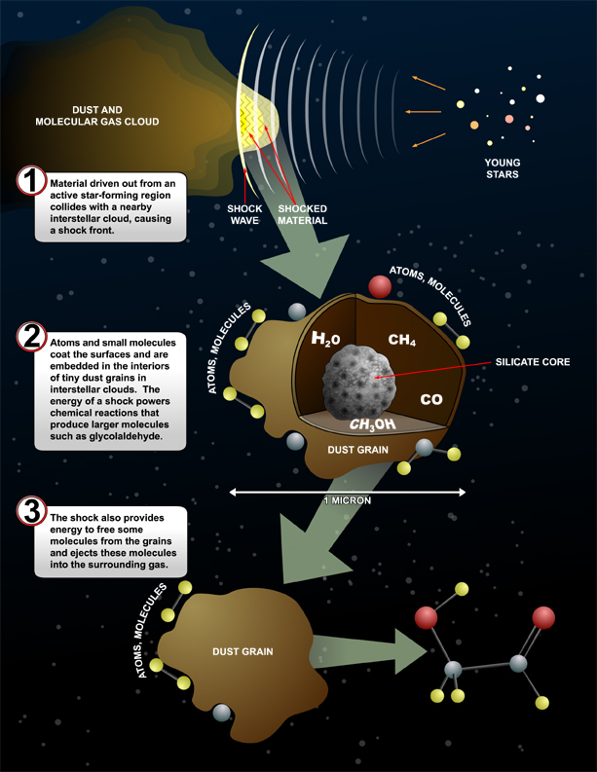
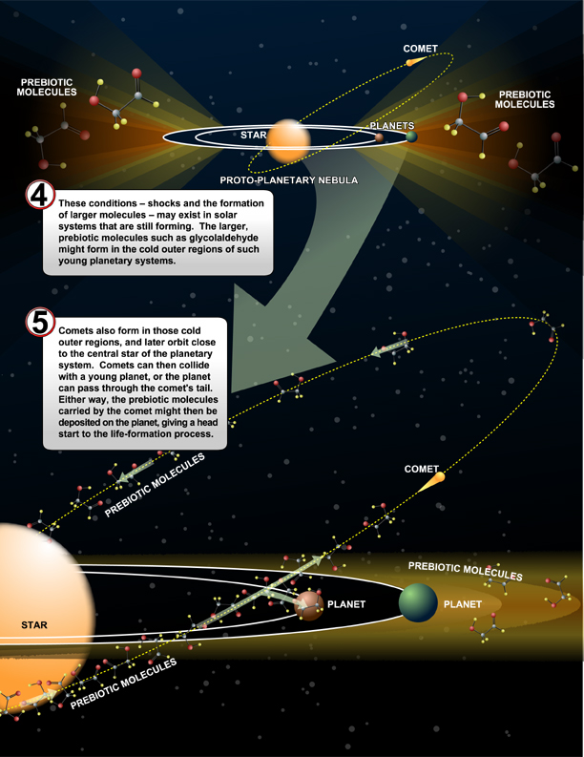
COMs & The Origin of Life

Slide 13
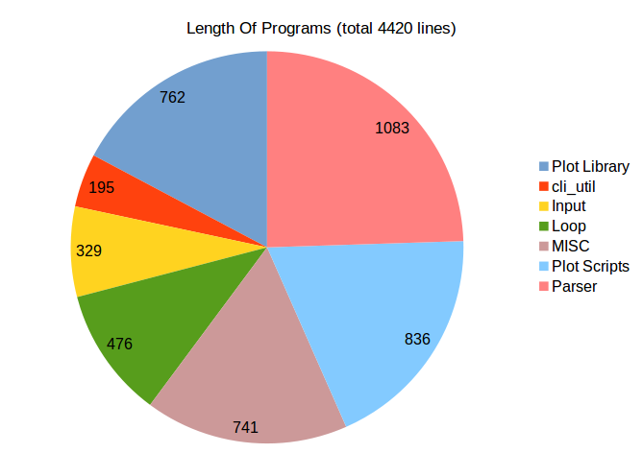
The Framework:

Slide 14
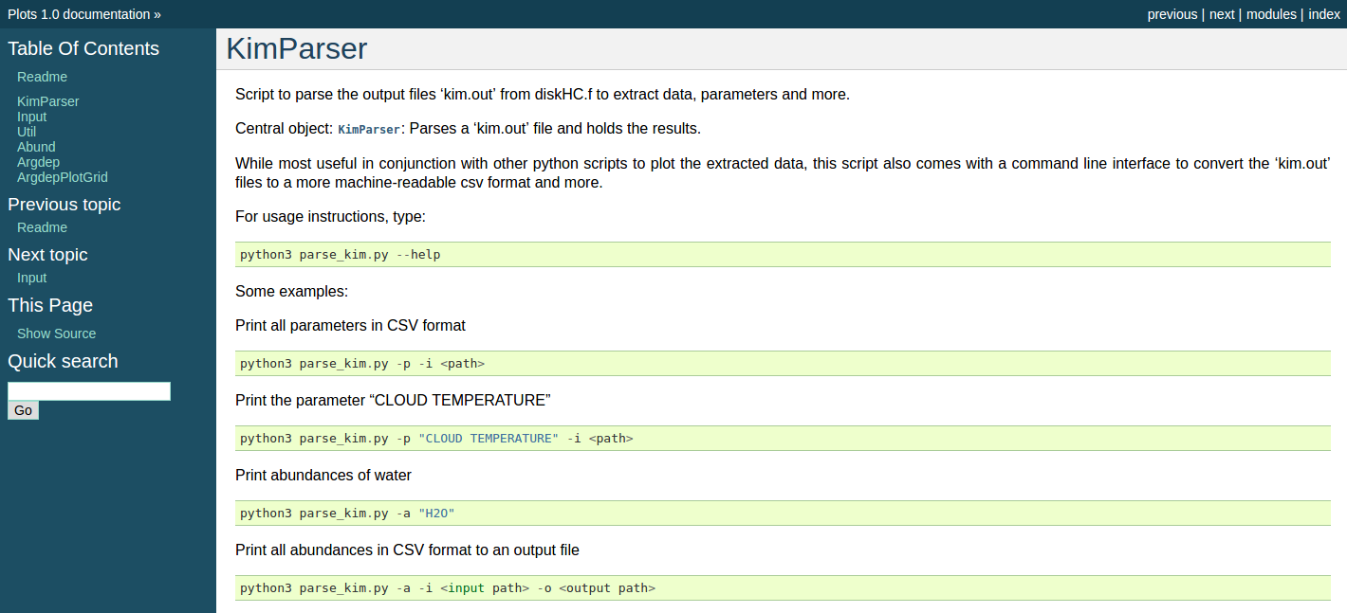
Documenting the Code:

Slide 15
ODEs

Slide 16
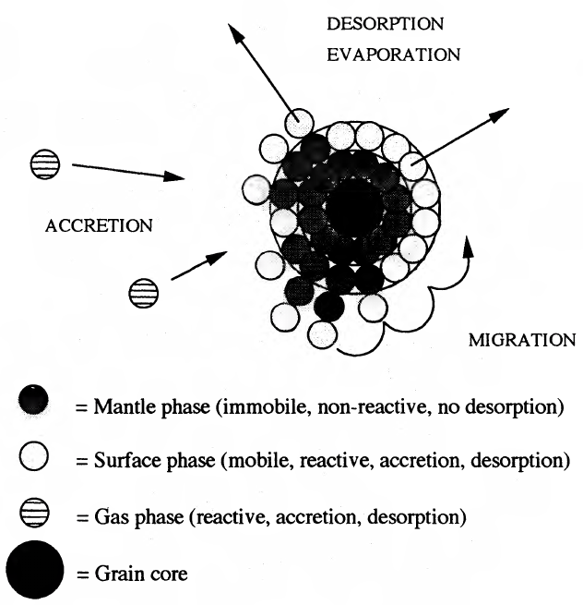
The Grain

